Slide 1
Introduction to Air Pollution
Presented by
Dr. Yu-Chieh Ting

Slide 2
The Carbon Cycle – Carbon Chemistry
All living systems on earth consist of molecular arrangements of the elements: carbon, oxygen, hydrogen, and most contain nitrogen.
These four so-called biophile elements have an affinity for each other so as to form complex organic compounds.
All of the earth’s creatures are carbon-based.
Biological processes, especially photosynthesis and respiration, by which energy is stored and used by organisms requires the C cycle
Much of this has to do with atomic structure of C.
The atomic number of C is six, with four electrons in its outermost shell.

Slide 3
This electron configuration is a tetrahedron and its oxidation state is often tetravalent.
The C atom’s theoretical tetrahedral shape minimizes the repulsion between pairs of electrons. For example, methane (CH₄) assumes the molecular configuration of four equidistant H atoms surrounding the C atom (i.e. four C-H bonds)
This tetravalence means that C can bond as C₄⁺ or as C₄⁻, i.e. it can either give four away or gain four electrons.
C seldom forms ionic bonds, readily forms covalent bonds, i.e. most of the molecules formed with C are covalently bonded.
This is the main reason that so many organic compounds are possible, and are the vast majority of compounds important in the environmental and medical sciences.
Notes:
Tetrahedron: 四面體
Tetravalent: 四價的
Repulsion: 排斥作用

Slide 4
The negative and positive tetravalence are prevalent, but certainly are not C’s only oxidation states.
C may have any oxidation state from +4 to -4 .
Since most biochemicals and tissues consist of organic compounds, the carbon cycle plays numerous roles in air pollution, no matter the scale of the receptor.
At the cellular scale, airborne organic toxicants interfere with cellular and genetic material, which leads to cancer and other diseases.
At the personal scale, people inhale carbon monoxide, volatile organic compounds (VOCs), organometallic compounds, and carbon-containing aerosols.
At the regional scale, mobile sources and vegetation (e.g. coniferous forests) emit VOCs that are part of mix needed to generate photochemical oxidant smog and ground level ozone.
At the planetary scale, chlorofluorocarbons (CFCs) and other halogenated compounds contribute to stratospheric ozone degradation; and CFCs, methane, and carbon dioxide are greenhouse gases.

Slide 5
The four electrons in the outer shell means that living systems can both oxidize and reduce C.
Oxidation is the act of losing electrons from the outermost shell; reduction is the act of gaining electrons.
Carbon redox occurs abiotically, e.g. by photochemical and thermal processes, and biotically.
Biotic reduction often takes place in the absence of molecular oxygen (O₂), such as in the rumen of cattle, in sludge at the bottom of a lagoon, or in buried detritus on the forest floor.
Anaerobic bacteria obtain energy by reduction, breaking down organic compounds into methane (CH₄) and water.

Slide 6
Conversely, aerobic microbes get their energy from oxidation, forming carbon dioxide (CO₂) and water.
Plants absorb CO₂ for photosynthesis, the process whereby plants convert solar energy into biomass and release O₂ as a by-product.
The essential oxygen is actually the waste product of photosynthesis and is derived from carbon-based compounds.
Respiration generates carbon dioxide as a waste product of oxidation that takes place in organisms, so there is a balance between green plants’ uptake of CO₂ and release of O₂ in photosynthesis and the uptake of O₂ and release of CO₂ in respiration by animals, microbes, and other organisms.
Hydrocarbons are formed when C reacts with hydrogen.
In the strictest definition of organic chemistry, a hydrocarbon contains only C and H.
A hydrocarbon molecule that contains the maximum number of H atoms is said to be saturated.

Slide 7
Hydrocarbons can be direct air pollutants (e.g. VOCs), as well as indirect air pollutants when they contribute to the formation of other pollution (e.g. photochemical reactions to form ozone and smog).
Combined with oxygen and hydrogen, carbon forms the biochemicals, including sugars, cellulose, lignin, chitins, alcohols, fats, and esters.
Combined with nitrogen, carbon forms alkaloids-naturally occurring amines produced by plants and animals, which combine to form proteins.
Combined with sulfur, carbon is the source of antibiotics, proteins, and amino acids.
Combined with phosphorus and a few other elements, carbon forms ribonucleic acid and deoxyribonucleic acid, the chemical codes of life.

Slide 8
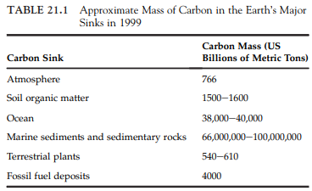
From a mass balance perspective, C-based compounds that are considered to be air pollutants comprise a very small fraction of the carbon cycle (see Table 21.1).
Carbon compounds are at the center of technological, materials science, medical, and environmental breakthroughs.
Many nanomaterials are carbon-based, such as carbon-60 (C₆₀).
The functional groups attached to the outside of these nanospheres and tubes determine their usefulness and the potential hazards.

Slide 9
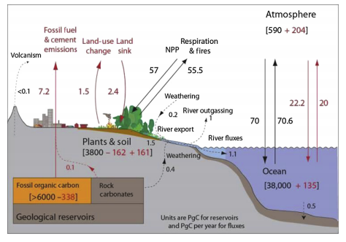
The Carbon Cycle – Carbon Sinks and Sources
Carbon in its many inorganic and organic species is cycled continuously through the environment (See Figure below)

Slide 10

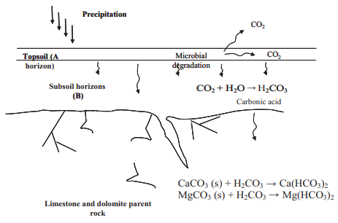
Figure above demonstrates the diversity of C sinks and sources.
if C can remain sequestered in the soil, roots, sediment, and other compartments, it is not released to the atmosphere.
Thus, sequestering C is a means of ameliorating climate change by decreasing the amount of greenhouse gases released.
Even relatively small amounts of methane and carbon dioxide can profoundly increase the atmosphere’s greenhouse potential.

Slide 11
An organic compound is a compound that includes at least one carbon-to-carbon or carbon-to-hydrogen bond.
C bonds to itself and to other elements in a myriad of ways, forming single, double, and triple bonds with itself. This makes for millions of possible organic compounds.
There are large ranges of solubility for organic compounds, depending upon the presence of polar groups in their structure.
The addition of an alcohol group to the gas ethane to produce ethanol, e.g. by fermentation and other types of anaerobic digestion, changes the phase and increases aqueous solubility.
This means that considerations for siting a factory that makes use of organic compounds must take into account the physical, chemical, and biological affinities of all the substances, from the raw materials to intermediate compounds to the intended product.
Notes:
Fermentation: 發酵

Slide 12
It also determines any pollution control devices. For example, if intermediate products have lower vapor pressures than raw materials, they will have to be addressed as air pollutants, whereas all the liquid phase compounds may be multiphase pollutants.
Some may be released through leaks and conduits as liquids, but a portion will also partition to the gas phase.
Alkanes are hydrocarbons that form chains with each link comprising the carbon. A single link is CH₄, methane.
The carbon chain length increases with the addition of carbon atoms which not only increases molecular weight but many other physicochemical characteristics, such as decreasing aqueous solubility and vapor pressure.
The aromatics are based upon the six-carbon configuration of benzene (C₆H₆). The carbon-to-carbon bond in this configuration shares more than one electron, so that the benzene molecule has alternating double and single bonds between the carbon atoms. The double and single bonds flip; i.e. they resonate.
Notes:
Conduits: 管道
Resonate:共振

Slide 13
The organic compounds can undergo substitutions of the hydrogen atoms.
These substitutions render new properties to the compounds, including changes in solubility, vapor pressure, and toxicity.
Halogenation often renders the substitution molecule less reactive, more lipophilic, and increase bioavailability and toxicity.
By a vast majority, most carbon-based compounds are organic, but a number of inorganic compounds are also important to air pollution.
CO₂ is an inorganic compound given that its C is bonded with O atoms and not with other C or H atoms.
Cyanide compounds (CN) and carbon monoxide (CO) are also inorganic compounds.
Others include inorganic acids, e.g. carbonic acid (H₂CO₃) and cyanic acid (HCNO) and compounds derived from reactions with the anions carbonate (CO₃) ²⁻ and bicarbonate (HCO₃⁻).
Notes:
Lipophilic: 親脂性的

Slide 14

The Carbon Cycle – Carbon Equilibrium and Cycling
Many carbon-based molecules exist in equilibrium with one another. For example, Figure (slide 10) demonstrates the equilibrium among carbonates, bicarbonates, organic compounds, carbonic acid, and carbon dioxide.
On a global scale, uncontaminated rain’s mean pH is about 5.6, owing to its dissolution of carbon dioxide, CO₂.
As the water droplets fall through the air, the CO₂ in the atmosphere becomes dissolved in the water, setting up an equilibrium condition:
The CO₂ in the water reacts to produce hydrogen ions, as

Slide 15
Assuming the mean partial pressure CO₂ in the air to be 3.0 * 10⁻⁴ atm, it is possible to calculate the pH of water in equilibrium.
Such chemistry is always temperature dependent, so let us assume that the air is 25 °C.
The current mean concentration of CO₂ in the troposphere is approximately 370 ppm, but this concentration is rising by some estimates at a rate of 1 ppm per year.
Henry’s law provides a way to explain C equilibrium.
The law states that the concentration of a dissolved gas is directly proportional to the partial pressure of that gas above the solution:
Where, K_{H} = Henry’s law constant; p_{a} = partial pressure of the gas; and [c] = molar concentration of the gas.
Or
where, C_{W} is the concentration of gas in water.

Slide 16

Henry’s law is a function of a substance’s solubility in water and its vapor pressure and expresses the proportionality between the concentration of a dissolved contaminant and its partial pressure in the open atmosphere at equilibrium.
The Henry’s law constant is an example of an equilibrium constant, which is the ratio of concentrations when chemical equilibrium is reached in a reversible reaction, the time when the rate of the forward reaction is the same as the rate of the reverse reaction.
The CO₂ concentration of the water droplet at equilibrium with air is obtained from the partial pressure of Henry’s law constant:
The change from carbon dioxide in the atmosphere to carbonate ions in water droplets follows a sequence of equilibrium reactions:

Slide 17
The processes that release carbonates increase the buffering capacity of natural soils against the effects of acidic water (pH < 5).
The ionic strength of the receiving soil or surface waters determines the actual change in pH.
The concentration of carbon dioxide (CO₂) is constant, since the CO₂ in solution is in equilibrium with the air that has a constant partial pressure of CO₂.
The two reactions and ionization constants for carbonic acid are:
K_{a1} is four orders of magnitude greater than K_{a2}, so the second reaction can be ignored for the purposes of C equilibrium.

Slide 18

The solubility of gases in liquids can be described quantitatively by Henry’s law.
CO₂ in the atmosphere at 25 °C, the Henry’s law constant, and the partial pressure can be applied to find the equilibrium.
The K_{H} for CO₂ =3.4* 10⁻² mol l⁻¹ atm⁻¹ . The partial pressure of CO₂ is found by calculating the fraction of CO₂ in the atmosphere.
Assuming a mean concentration of CO₂ in the earth’s troposphere to be 370 ppm by volume in the atmosphere, the fraction of CO₂ must be 370 divided by 1,000,000 or 3.7 *10⁻⁴ atm
The carbon dioxide and carbonic acid molar concentration can now be found:
Notes:
式子由來

Slide 19
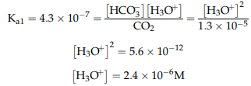
The equilibrium is [H₃O⁺] = [HCO₃⁻]. Taking this and the previously calculated CO₂ molar concentration gives
The log of 2.4*10⁻⁶ is -5.63, so the negative log is about 5.63. Or the droplet pH is about 5.63.
Carbon dioxide, with water, is the ultimate product of aerobic microbial respiration, but it is also an important greenhouse gas.
From the preceding discussion, a global increase in CO₂ concentrations must also change the mean acidity of precipitation.
If the current trend continues, a rather constant increase in tropospheric CO₂ concentrations is expected.
the increase from the present 370 to 400 ppm tropospheric CO₂ concentrations would be accompanied by a proportional decrease in precipitation pH.

Slide 20
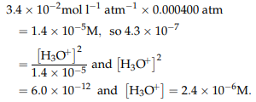
The molar concentration can be adjusted using the previous equations:
This is about -5.61, so the negative log is about 5.61. Or, the droplet pH is about 5.61.
The worldwide average water droplet pH would be decreased only slightly, i.e. about 0.02. This means that the increase in atmospheric carbon dioxide can be expected to contribute to greater acidity in natural rainfall.
The precipitation rates, i.e. the total amount of water released from the atmosphere and reaching the earth’s surface, would also be affected if greenhouse gas concentrations continue to increase, so any changes in atmospheric precipitation rates would also, on average, be expected to be more acidic.

Slide 21
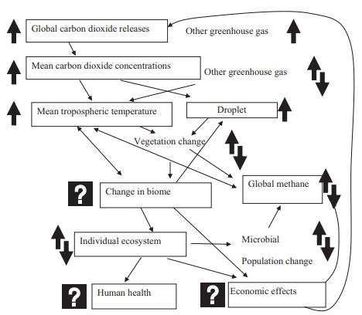
The Carbon Cycle – Carbon Cycling and Climate
The discussion in the previous section indicates that there are many drivers and constraints involved in climate (see Figure right).
The increased amounts of CO₂ will likely affect global temperature, which affects biomes and the kinetics within individual ecosystems.
Notes:
Biomes: 生物群落

Slide 22
Ecological structure, such as tree associations, canopies, and forest floors, as well as wetland structures may change, so that conditions may become reduced, with an attendant increase in anaerobic microbial decomposition, meaning greater releases of CH₄, which would mean increasing global temperatures, all other factors being held constant.
If greater biological activity and increased photosynthesis is triggered by the increase in CO₂, and wetland depth is decreased, CH₄ global concentrations would fall, leading to less global temperature rise.
Conversely, if this increased biological activity and photosynthesis leads to a decrease in forest floor detritus mass, then less anaerobic activity may lead to lower releases of CH₄.
In actuality, there will be increases and decreases at various scales, so the net effects on a complex, planetary system is highly uncertain.
Notes:
Detritus: 殘渣

Slide 23
It is important to note that much of the concern for acid rain has been rightly concerned about compounds other than CO₂, notably oxides of two other biophile elements, sulfur and nitrogen, which are discussed in the following chapter.
These compounds can dramatically decrease the pH of rain.
The increase in CO₂ means that the pH of rainfall, which is not neutral to begin with, can further adversely affect the fish and wildlife in and around surface waters as a consequence of C-based acidic compounds being added to the concentrations of sulfur and nitrogen compounds.
CH₄ is the product of anaerobic decomposition and human food production. Methane is also emitted during the combustion of fossil fuels and cutting and clearing of forests.

Slide 24
The concentration of CH₄ in the atmosphere has been steady at about 0.75 for over a thousand years, and then increased to 0.85 ppm in 1900. Since then, in the span of only a hundred years, it has skyrocketed to 1.7 ppm.
Methane is removed from the atmosphere by reaction with the hydroxyl radical (OH) as
This indicates that the reaction creates carbon dioxide, water vapor, and ozone, all which are greenhouse gases; so the effect of one molecule of methane is devastating to the production of the greenhouse effect.
The difference in gas concentrations and the exchange coefficients between the atmosphere and surface waters determines how quickly a molecule of gas can move across the ocean-atmosphere boundary.
It takes about 1 year to equilibrate CO₂ in the surface ocean with atmospheric CO₂, thus large atmosphere-ocean differences in CO₂ concentrations are common.

Slide 25
Biota and ocean circulation account for the majority of the difference.
The oceans contain vast C reservoirs. The atmosphere exchanges CO₂ with these reservoirs, wherein CO₂ reacts with water to form carbonic acid and its dissociation products.
With the increased atmospheric CO₂ concentrations, the interaction with the ocean surface alters the chemistry of the seawater resulting in ocean acidification.
Ocean uptake of anthropogenic CO₂ is primarily a physical response to increasing atmospheric CO₂ concentrations.
Increasing the partial pressure of a gas in the atmosphere directly above the body of water causes the gas to diffuse into that water until the partial pressures across the air-water interface are equilibrated.
The effects are complex, e.g. increasing CO₂ also modifies the climate, which in turn may change ocean circulation, which changes the rate of ocean CO₂ uptake.

Slide 26
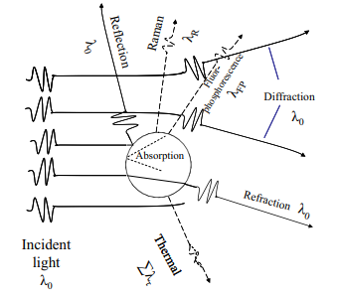
The earth acts as a reflector to the sun’s rays, receiving the radiation from the sun, reflecting some of it into space (i.e. albedo), and adsorbing the rest, only to reradiate this into space as heat.
Carbon cycling directly affects albedo by affecting the vegetative cover.
In effect the earth acts as a wave converter, receiving the high-energy high-frequency radiation from the sun and converting most of it into low-energy low-frequency heat to be radiated back into space.
In this manner, the earth maintains a balance of temperature.
The light energy and the heat energy have to be defined in terms of their radiation patterns, as shown in Figure.

Slide 27
The incoming radiation (light) wavelength has a maximum at around 0.5 nm and almost all of it is less than 3 nm.
The heat energy spectrum, or that energy reflected back into space, has a maximum at about 10 nm and almost all of it at a wavelength higher than 3 nm.
As both light and heat energy pass through the earth’s atmosphere they encounter the aerosols and gases surrounding the earth.
These can either allow the energy to pass through, or they can interrupt it by scattering or absorption.
If the atoms in the gas molecules vibrate at the same frequency as the light energy, they will absorb the energy and not allow it to pass through.
Aerosols will scatter the light and provide a “shade” for the earth. The incoming radiation is impeded by water vapor and oxygen and ozone, as discussed in the preceding section.
Notes:
Impede: 阻礙

Slide 28
Most of the light energy comes through unimpeded.
The heat energy, however, encounters several potential impediments. As it is trying to reach outer space, it finds that water vapor, CO₂, CH₄, O₃, and N₂O.
These compounds all have absorptive wavelengths in the middle of the heat spectrum.
Quite obviously, an increase in the concentration of any of these will greatly limit the amount of heat transmitted into space.
These gases are appropriately called greenhouse gases because their presence will limit the heat escaping into space, much like the glass of a greenhouse or even the glass in your car limits the amount of heat that can escape, thus building up the temperature under the glass cover.

Slide 29
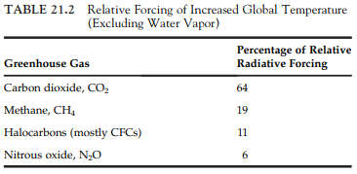
The effectiveness of a particular gas to promote global warming (or cooling, as is the case with aerosols) is known as forcing. The gases of most importance in forcing are listed in Table (right).
The effectiveness of CO₂ as a global warming gas has been known for over 100 years, but the first useful measurements of atmospheric CO₂ were not taken until 1957.

Slide 30
Certainly, not all greenhouse gases are C-based. Nitrous oxide is emitted to the atmosphere predominantly as a result of human activities, especially the cutting and clearing of tropical forests (which, as mentioned, also has deleterious albedo consequences).
The greatest problem with nitrous oxide is that there appear to be no natural removal processes for this gas and so its residence time in the stratosphere is quite long.
This is another example of the interrelationships and interdependencies between the C and N cycles.
Various atmospheric models used to predict temperature change over the next 100 years vary widely.
By the year 2100, even if we do not increase our production of greenhouse gases and international agreements are reached and subsequently followed, the global temperature is likely to be between 0.5 and 1.5 °C warmer than at present.
This effect on natural systems and dynamics in the oceans and atmosphere could be devastating.

Slide 31
The cycling of C indicates the numerous complexities in addressing air pollution science and engineering.
Pollution control efficiency and success have often been based on CO₂ production rates, i.e. the greater the amount of CO₂ leaving a stack, the better air pollution control equipment is operating. This is because complete combustion results in the production of CO₂ and H₂O.
Likewise, the production of CH₄ has been an indication of complete anaerobic digestion of organic compounds.
Both these indicators of pollution control success are greenhouse gases.

Slide 32
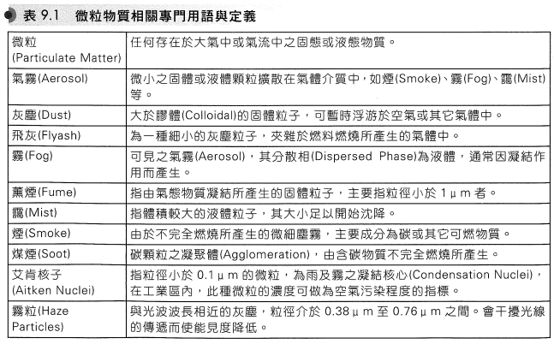
微粒物質之收集
微粒物質(Particulate Matter)
指任何以固態或液態存在大氣中之物質。人為空氣污染物中，約有10%是以微粒型態存在。
微粒物質之專門用語及其定義

Slide 33
微粒物質之潛在危害
對肺部構成健康上的威脅
降低能見度
增多雲霧及降雨量
增進大氣中化學反應
減少太陽輻射量而引起環境溫度及植物生長之變化
微粒的特性
一般而言，空氣傳播之微粒大小介於0.001至500 µm之間，大部分(75%)之粒徑大小在0.1至10 µm之間，其中又有約50 wt%的粒徑在0.1至2 µm之間。
粒徑低於0.1 m之微粒其作用與分子類似，因而具有與氣體分子碰撞引起大幅度自由運動的特徵。
大於1 µm而小於10 µm的顆粒會在空氣中懸浮，但大於10 µm的顆粒則具有很明顯的沉降速率。

Slide 34
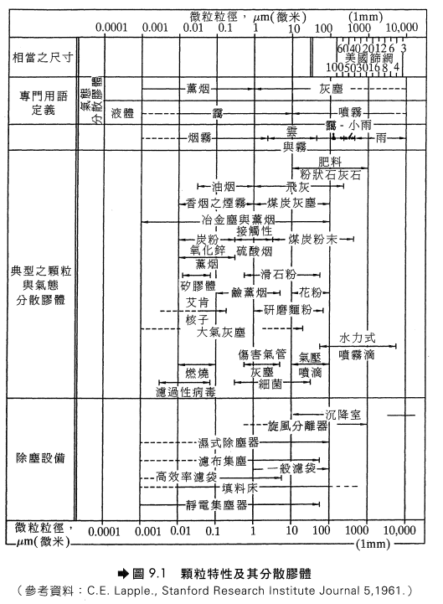
微粒的防制
圖9.1顯示各種不同粒徑的污染物及其適用之控制，普遍來說，較大的粒子通常來自粉碎、研磨等減少粒徑之操作或固體燃料之燃燒，且粒子粒徑之分布較為寬廣；而較小的粒子則通常來自蒸發-凝結、昇華-凝結等操作，例如氣體、液體燃料之燃燒及化學反應。

Slide 35
(一) 防制設備之選擇
不同粒徑的污染物決定不同的防制設備，選用防制設備時應考量之因素有
顆粒大小及其重量分布
所要處理的廢氣量及微粒負荷
廢氣的溫度及濕度
集塵效率
微粒是否有回收價值
操作及建造成本

Slide 36

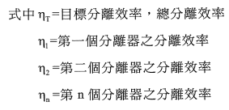
(二) 處理效率
當粒徑分布較為寬廣時，基於成本之考量，可先以較便宜之除塵設備去除較粗顆粒以降低其後高效率分離器的微粒負荷。
此類串聯組合式除塵設備的處理(分離)效率可以表示為:

Slide 37


微粒動力學 (Particle Dynamics)
微粒在運動過程中，受到下列力之影響:
重力(Gravitational Force)
離心力 (Centrifugal Force)
浮力 (Buoyancy Force)
拖曳力 (Drag Force)
(一)終端速度之推導
當重力與浮力及拖曳力平衡時，粒子將以終端速度(Terminal Velocity)移動。
粒子的沉降力F_{g}為粒子重力與浮力之差

Slide 38

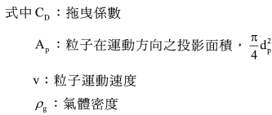
粒子沉降之反向力為拖曳力F_{D}，可表示為
當F_{g} = F_{D}時，粒子以終端速度u_{t}運動，所以

Slide 39
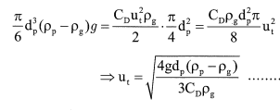


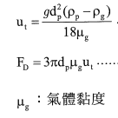
式中C_{D}為雷諾數 (Reynolds Number, Re = d_{P}ρ_{g}u_{t} / µ_{g})的函數
當Re<2時
(9-9)

Slide 40



康寧漢校正係數
對於d_{p}<40 µm的粒子，u_{t}以(9-9)計算誤差很小，但當d_{p}<4 µm時，粒子之運動受到氣體分子運動的影響，必須以康寧漢校正係數(Cunningham Correction Factor) K_{c}校正之
λ: 氣體分子平均自由徑 (Mean Free Path，室溫下之空氣為0.0652 µm)
(9-12)
在常壓下，對於d_{P} > 1 µm 之粒子
T: 絕對溫度，°K。

Slide 41


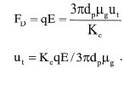
粒子在其他力場之終端速度
若粒子所承受之外力為離心力時，(9-12)式中之重力g可以離心力 V²/r 替代
(9-15)
若粒子在電場E中移動，且負電荷q，則拖曳力與靜電力平衡時

Slide 42
微粒物質的特性
微粒物質控制設備之效率與欲去除之微粒特性有密切關係，其中尤以粒徑大小及其分佈之影響最大。
一、粒徑大小之表示方式
(一) 依尺寸大小
微粒之大小可以其粒徑大小表示，唯對於非圓形或不規則形狀之微粒物質，可以下列方式表示其大小尺度。
Feret直徑: 微粒投影形狀，邊與邊之最大距離。
馬丁(Martin)直徑: 將微粒之投影面積分割為兩個相等面積之投影部分，則此分割直徑之長度即稱馬丁直徑。
等圓直徑: 與微粒投影面積相同的圓形所對應之直徑即稱為等圓直徑，又可稱為投影面積之相當直徑(Equivalent Diameter)。
通常Feret直徑>等圓直徑>馬丁直徑。
須注意若粒子之投影方向不同，所測得的直徑也隨之改變，因此必須使每一粒子之投影方向相同，且須由多組數據取其平均值作為直徑，所得到的數值才具有代表性。

Slide 43
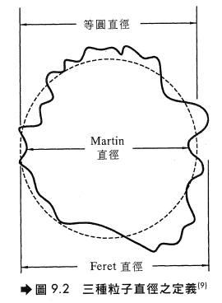

Slide 44
(二) 依沉降速度
亦可以粒子之沉降速度來定義該粒子的直徑。若兩個不同粒子具有相同的沉降速度，則不論其真實直徑大小、組成和形狀，均可認定它們具有相同的直徑。下列兩種定義最常用:
氣動直徑(Aerodynamic Diameter): 當粒子和某一單位密度之圓球粒子具有相同的氣動特性時，則此單位密度圓球之直徑即為粒子之氣動直徑。即無論粒子之形狀或密度，只要沉降速度相同，則這些粒子之氣動直徑均相等。
Stokes直徑: 當一個粒子和一圓球粒子之密度及沉降速度相同時，則此圓球之直徑便稱為該粒子之Stokes直徑。Stocks直徑和氣動直徑之差異在於Stokes直徑要求兩粒子密度要相同，而氣動直徑則無此要求。
(三) 粒徑與來源之關係
廢氣中微粒物質之粒徑與其來源有密切關係，通常由機械研磨、粉碎等作用產生之微粒物質，其粒徑一般較大，包括塵粒、水滴、粉末等；若由化學反應所產生之微粒物質，其粒徑一般較小，如煙、燻煙、酸霧等。

Slide 45
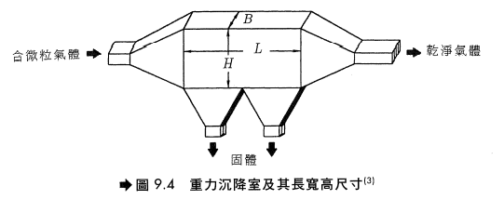
初級分離方法
較粗大的微粒物質可以初級分離法先行去除，基本上，初級分離設備是利用下列方法而達到分離的目的。
降低氣體速度。
改變流動方向。
微粒與擋板之撞擊作用。
重力沉降室(Gravity Settling Chamber)
基本定理

Slide 46



氣體在重力沉降室之停留時間，θ
式中U為氣體的直線速度，V為沉降室內部體積。
在停留時間內，微粒物質在室內垂直方向之沉降距離，h
重力沉降室之效率
(9-20)
Notes:
Q: 體積流率

Slide 47

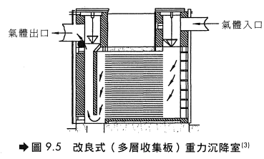
改良式沉降室
(一) 原理
當h = H時，重力沉降室可分離之最小粒徑為
(9-21)
由(9-20)及(9-21)可知，(d_{P})_{min} 隨著H/L比值降低而降低，且效率亦隨之提高。因而在構造上，與其建造一個低且長的重力沉降室，不如在沉降室內加裝隔板，如圖所示

Slide 48
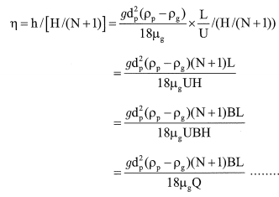

(二) 構造
此種改良式沉降室含有多個水平或傾斜的收集板，其間距約為10-30公分，通常可去除粒徑約15 µm的粒子。其優點為佔地面積較小，缺點為清洗不易，但設計上可使收集板傾斜或不時轉動收集板或以水沖洗克服。
(三) 沉降效率
假設改良式重力沉降室有N個收集板，則可得效率如右(上式)
當η = 1時，可求得(d_{P})_{min}

Slide 49

缺點:
佔地面積大
收集效率較低
(四) 與其他種類的集塵設備比較，重力沉降室優缺點
優點:
建造、操作成本低
壓降低
構造簡單、操作簡單
乾式收集，沒有水處理問題
(五) 設計上應注意事項
因沉降室內之亂流會導致粒子沉降速度計算之偏差，再加上已收集在版面上粉塵之在飛揚問題(Reentrainment)，效率之計算修正如下式較可符合工程設計之要求

Slide 50



若進料氣體之粒徑分佈寬廣，則效率計算如下

Slide 51
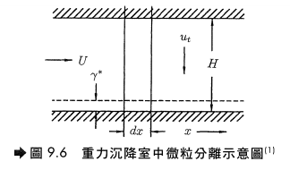

重力沉降室效率另一種計算方法
將氣流看成完全混合而在收集盤周圍有一層流層(Laminar Layer)，各種大小粒子連續地向下沉降到此層流層且並不會再回到亂流區，如圖
流經d_{x} 距離到達層流層被去除之粒子分數為dN_{P}/N_{p}，所需時間為t = d_{x}/U，同一時間內，粒子下降之垂直最大距離為y = t*u_{t}

Slide 52




y/H = 已達層流層且因此由主氣流被除去之粒子分數，所以
積分可得
X=0時，N_{p} = N_{p0}，x = L時，N_{p} = N_{pL}，所以
收集效率

Slide 53
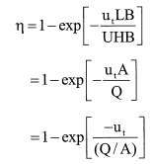
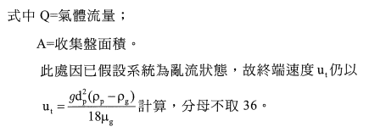
假設沉降室之寬為B

Slide 54
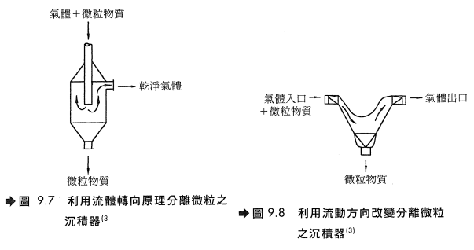
微粒沉積器(Solid traps)
原理
主要是利用固體要較大的慣性，並在沉積器內改變流動方向而達到與氣體分離的目的。常用於微粒負荷較高(High Dust Load)及較小流量之場合，例如冶礦爐(Metallurgical Furnace)出口即經常裝設此類沉積器，如圖所示

Slide 55
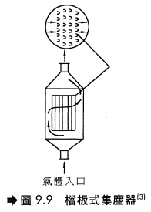
其他集塵器
其他利用相同原理的集塵器尚有如圖所示的擋板式集塵器，亦利用固體有較大之慣性而撞擊沉積在擋板表面。
以上所述之集塵器其分離界線徑約在20~40 µm之間，壓力損失很小，約在20~30 mm水柱高度。

Slide 56
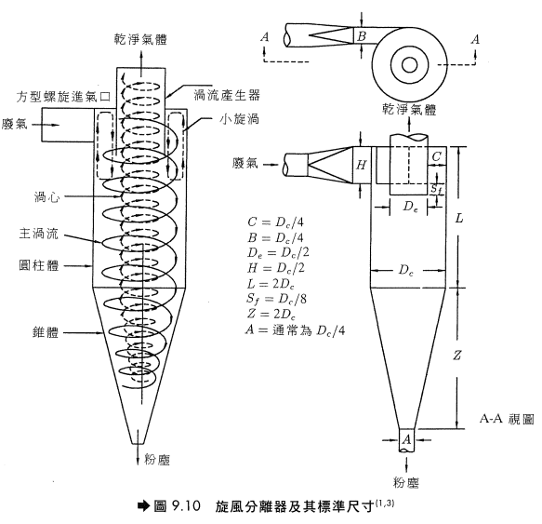
旋風分離器(Cyclone Separator)
原理
旋風分離器為最受歡迎且經濟有效之微粒物質控制設備，可廣泛應用於前處理設備以去除較大之顆粒物，再予以進一步處理。標準尺寸之旋風分離器如圖所示，髒空氣由偏離中心線之方向吹入圓錐形之柱狀體而於圓錐內造成強烈旋轉，較重之顆粒碰撞到柱狀體之牆壁，由於摩擦作用使速度減慢，再由圓錐底部排出。在圓柱體中間之乾淨氣體則由頂部排出。

Slide 57

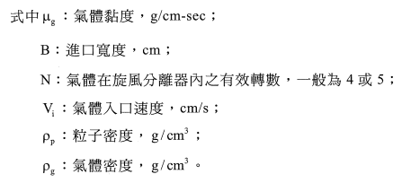
基本定理推導
氣體進入旋風分離器後，氣體之切線速度隨著逐漸接近軸心而增加，在靠近牆壁的地方，淨氣體移動方向為向下；而靠近軸心的地方，淨氣體移動方向為向上，因此必存在一點使氣體向上及向下移動彼此平衡而使氣體垂直速度(Vertical Velocity)為零。此時微粒物質各有一半的機會沉降或溢出，因此定義截留直徑(Cut Diameter)，d_{pc} 為50%顆粒可被去除之顆粒直徑
(9-30)

Slide 58


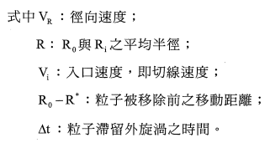
(9-30)式推導如下:
設R₀ = 旋風分離器之外半徑
R_{i} = 旋風分離器之內半徑
R* = 使d_{p}大小的粒子在N轉中達到外壁之最小半徑。
則部分收集效率η_{d} (Fractional Efficiency)
(9-31)
式中R₀ – R_{i}亦即旋風分離器矩形入口的寬度B。
由 (9-15)式
(9-32)

Slide 59





當η_{d} = 1.0時，可得旋風分離器可分離之最小顆粒粒徑(d_{p})_{min}
代入(9-32)式
代入(9-31)式
(9-35)
當η_{d} = 0.5時有截留直徑(Cut Diameter)，d_{pc}

Slide 60


分離總效率
Lapple將類似比例的旋風分離器數據歸納整理而得圖示曲線，由此圖可求出單一顆粒之分離效率，旋風分離器之總效率可以(9-26)式求得
比較(9-31)式、(9-35)式可發現旋風分離收集效率有如下關係
因此，旋風分離器效率隨下列因子而增加:
(1) 粒徑 (2)粒子密度 (3) 氣體入口速度 (4)旋轉數 (5)集塵器機體長度(長度長則旋轉數高) (6)器壁之光滑度。
反之與下列因子成反比:
(1) 氣體黏滯力 (氣體之黏滯力隨溫度增加而增加) (2) 集塵器直徑 (3) 氣體入口面積

Slide 61
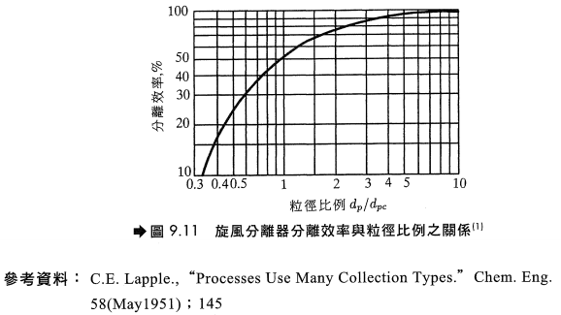

Slide 62


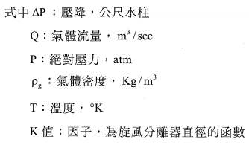
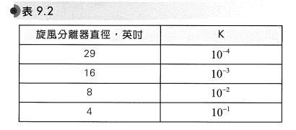
一般旋風分離器的壓降是以氣體入口速度水頭的數目(No. of inlet velocity head)來計算，可表示為
一般可以下列經驗式算出

Slide 63
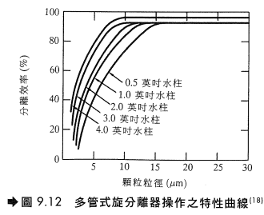
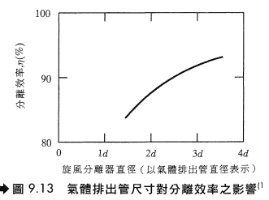
旋風分離器之分離效率為壓降之函數，壓降越大，則分離效率越高，如下左圖。
縮小氣體排出管之直徑會使系統壓降升高，因而分離效率亦隨之提高，如下右圖。
一般氣體排出管之直徑約為本體直徑之0.4倍，另外縮小本體直徑亦可使壓降提高。

Slide 64


旋風分離器之設計步驟
選定一標準尺寸並估算容許壓降 (以cm水柱表示)。
決定可損失之速度水頭，第一次計算可取8。
∆P (cm 水柱) / 氣體密度 (g/cm³) = ∆P (cm 氣體) = 8*(V_{i}² / 2g_{c})，故可求得V_{i}。
氣體流量Q，入口面積D_{c}² / 8 (參考圖9.10， B*H = D_{c}² / 8)
因V_{i}、Q已知，可求得D_{c}，B。
利用(9-30)式求得d_{pc}。
求d_{p} / d_{pc}比值，再由圖9.11求得對應之分離效率η_{i}。
或以下式估算η_{i}

Slide 65

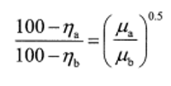



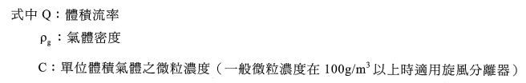
由顆粒之粒徑分佈，利用(9-26)式計算平均效率。
若平均效率不符合要求，可考慮多管式旋風分離器，以提高收集效率。
其他狀況下之效率計算
當在設計狀況以外之情形下運轉時，旋風分離器的效率可以下列公式計算。

